Slide 1
Maskote Zinc Stop-Off
To Prevent Toe Cracking during Galvanizing

Slide 2
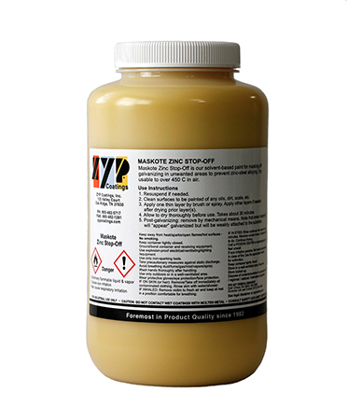
Maskote Zinc Stop-Off
ZYP Coatings’ Maskote Zinc Stop-Off is a specially formulated solvent-based paint
Withstands normal alkaline and acid bath cleaning prior to galvanizing
Prevents zinc-steel alloying during galvanizing
As an added benefit, Maskote prevents toe crack formation during galvanizing of steel where thin-walled parts are welded to thick-walled parts

Slide 3
How Maskote works
Maskote is a proprietary blend of organic and inorganic high temperature materials
Once applied and dried, Maskote forms a sealed layer on the metal surface
When exposed to heat in the form of molten zinc, Maskote forms a tough carbon char, similar to burnt sugar on a frying pan, which is held onto the metal substrate by a high temperature inorganic binder system
The molten zinc is unable to penetrate or remove the Maskote layer, protecting the underlying steel from molten zinc
Steel
Galvanized steel
Maskote
Acid/base cleaning
Maskote char removed
Steel
Molten zinc

Slide 4
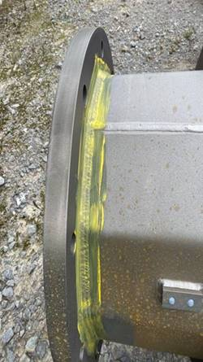
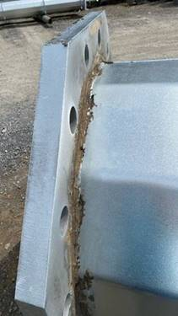
How Maskote prevents “Toe Cracks”
The mechanism by which Maskote prevent toe cracks is not fully understood.
However, by applying Maskote to the welded region, it is preventing the reaction between molten zinc and steel. The welded area is thus unchanged chemically, and mechanical stresses associated with that chemical change should be mitigated. Also, thermal insulation provided by the Maskote layer could reduce the stress on the weld during galvanizing

Slide 5
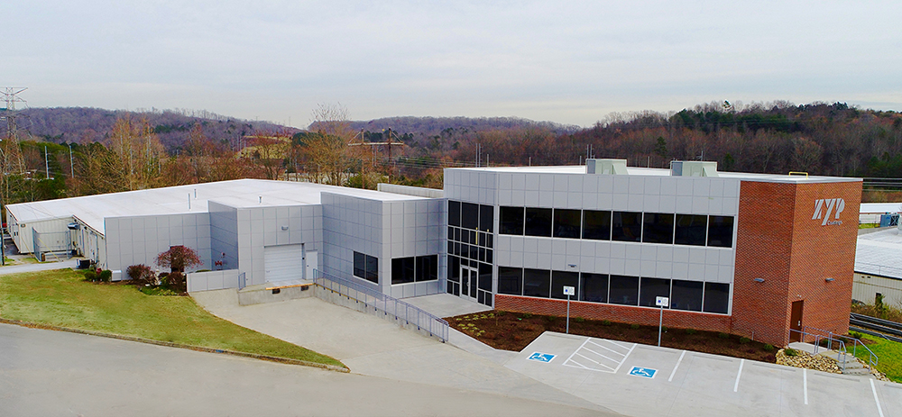
Contact us
ZYP Coatings, Inc.
Oak Ridge, TN
Phone: (865) 482-5717
Technical support: pritt@zypcoatings.com

